Slide 1
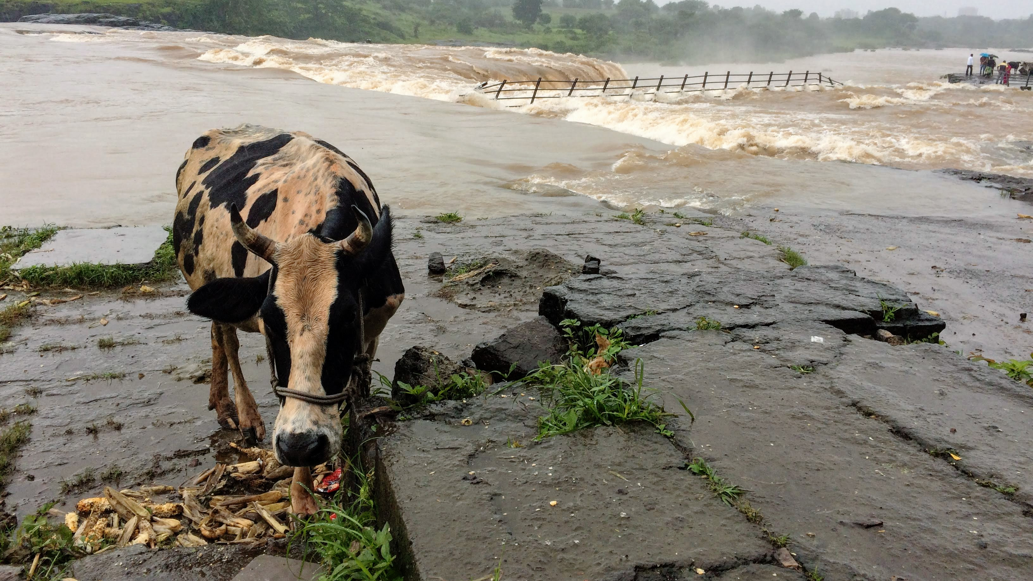
Hydrological
Module
Mikhail Smilovic
FUSE team meeting on June 8, 2020

Slide 2
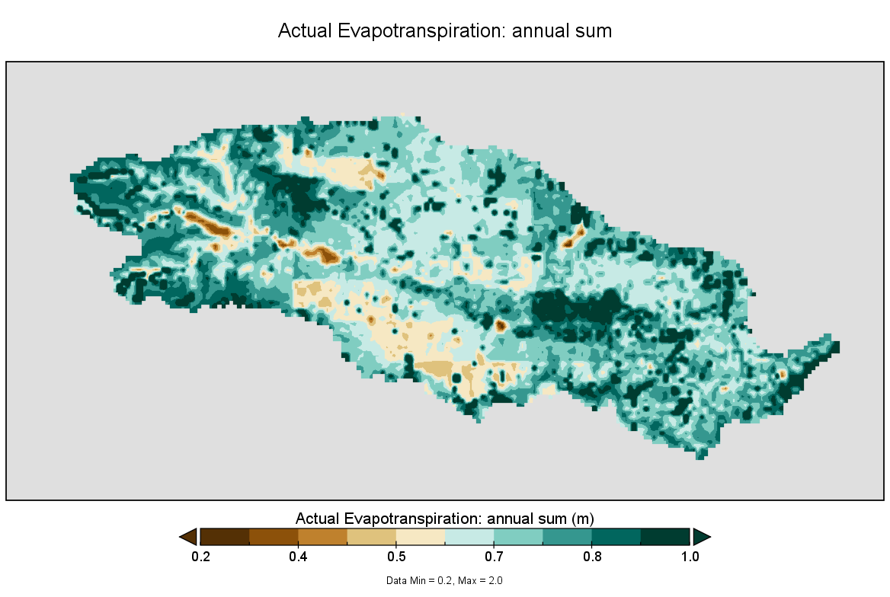
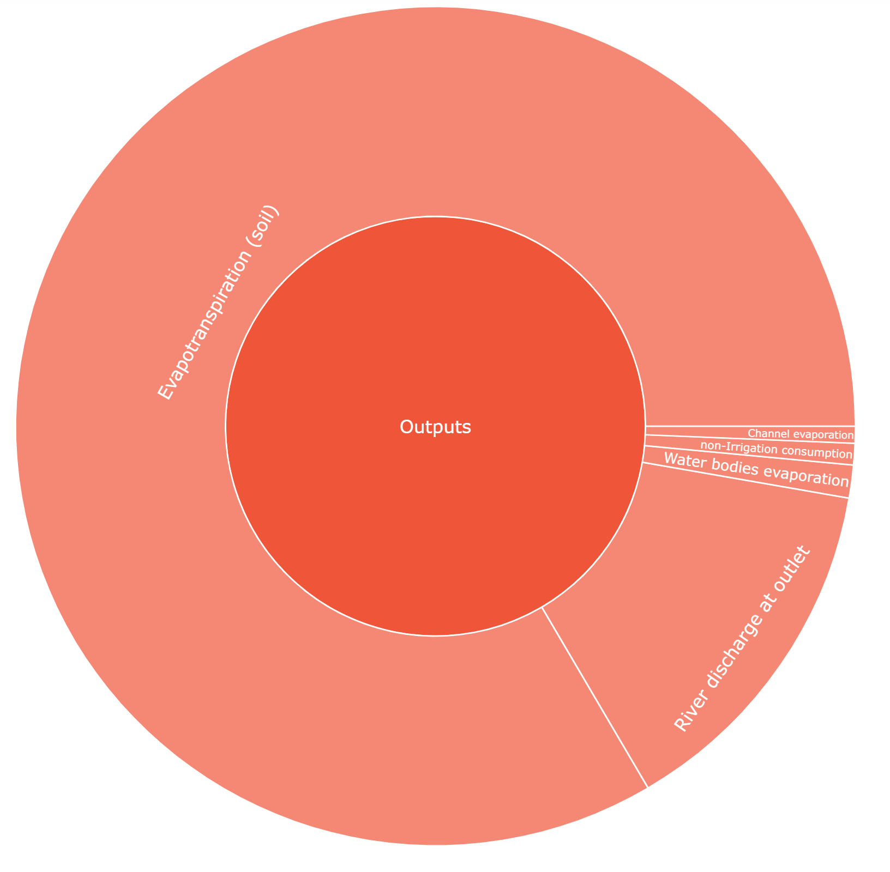
Outputs:
Last time, we talked of the water balance. The main output from the Nira basin watershed is evapotranspiration on land, namely, water consumed by plants and evaporation from the soil and canopy.
Highlight
Evapotranspiration (land)
Channel evaporation
OUTPUTS
non-Irrigation consumption
River
discharge
Waterbody evaporation
Evapotranspiration on land is the dominant outflow from the watershed.

Slide 3
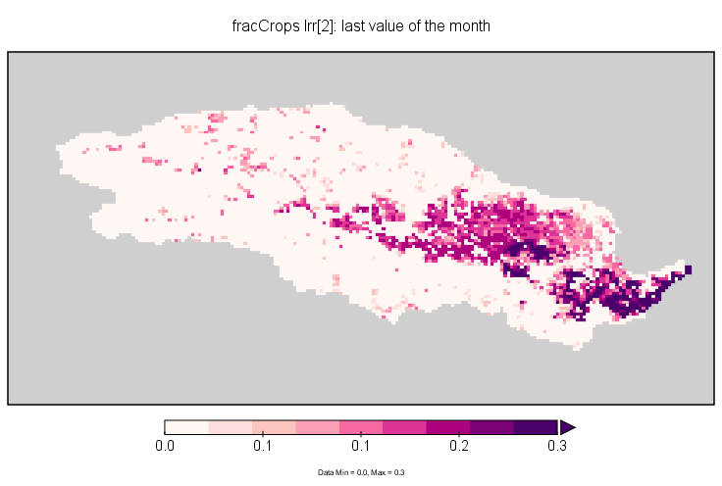
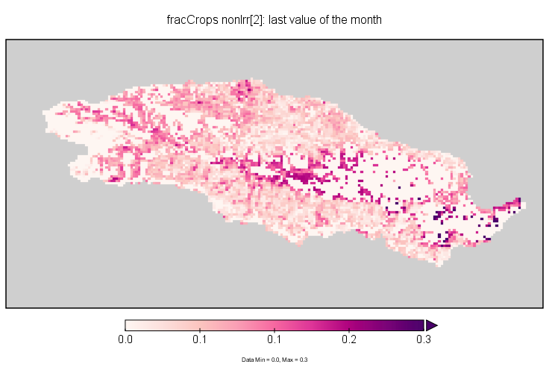
Sugarcane, variety pre-seasonal
Fraction of land planted
Fraction of land planted
Irrigated
non-Irrigated

Slide 4
1.
Input for total Irrigated land and non-irrigated land
2.
Input for each crop / irrigation status
3.
On the first day of each month, crops that are finished growing are harvested. Then, if land is available, crops to be planted in this month are sown
Crop | Planting month | Growing length (months)
Sugar1 | July | 17
Sugar2 | October | 15
Sugar3 | January | 12
Sorghum | November | 4
Groundnut | June | 5
Wheat | November | 5
Maize | November | 5
4.
Each crop has four growth stages determining potential water use, determined by scaling a reference water use by crop- and growth-stage specific water use coefficients (Kc)
Irrigated
Irrigated
non-Irrigated
non-Irrigated

Slide 5
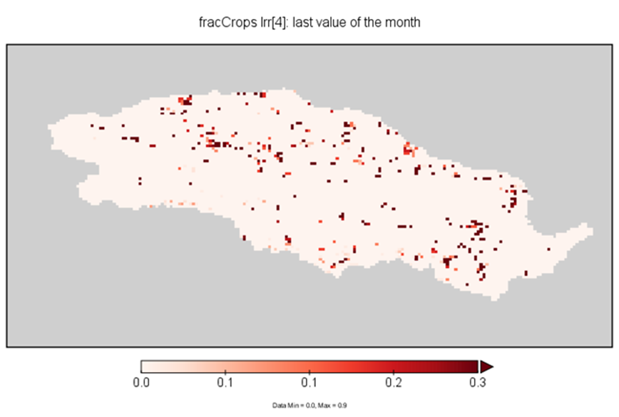
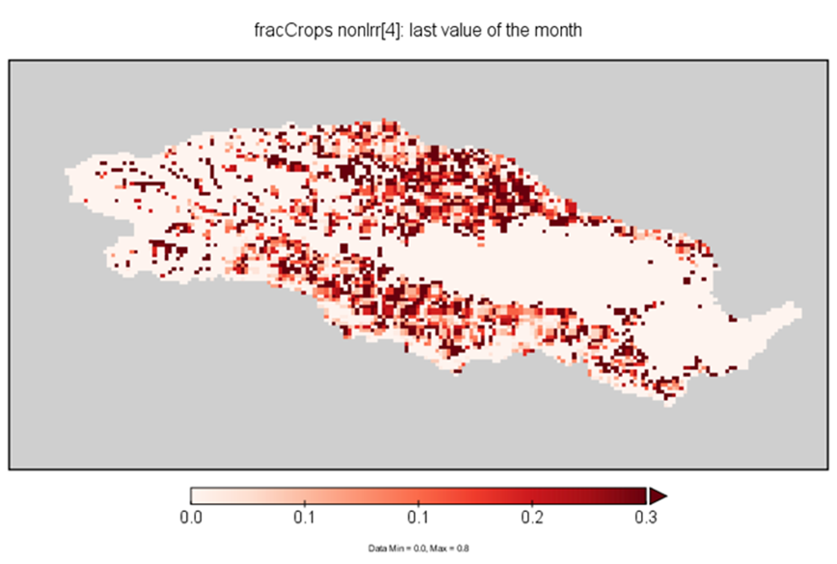
Sorghum
Fraction of land planted
Fraction of land planted
Irrigated
non-Irrigated

Slide 6
Irrigated
Sugarcane, v. pre-s
Sorghum
Non-Irrigated

Slide 7
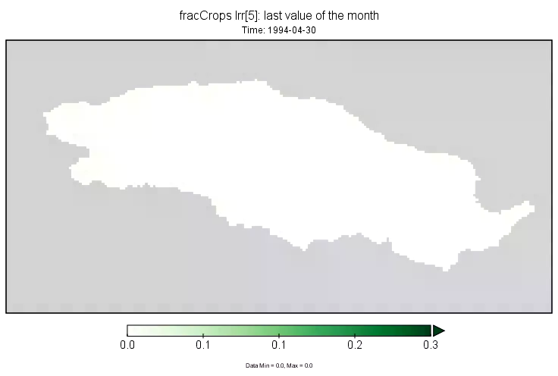
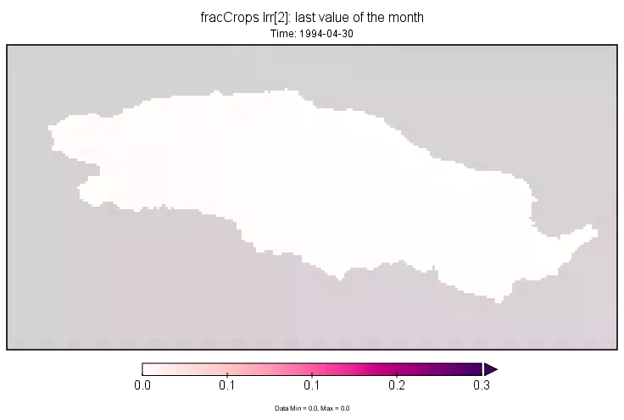
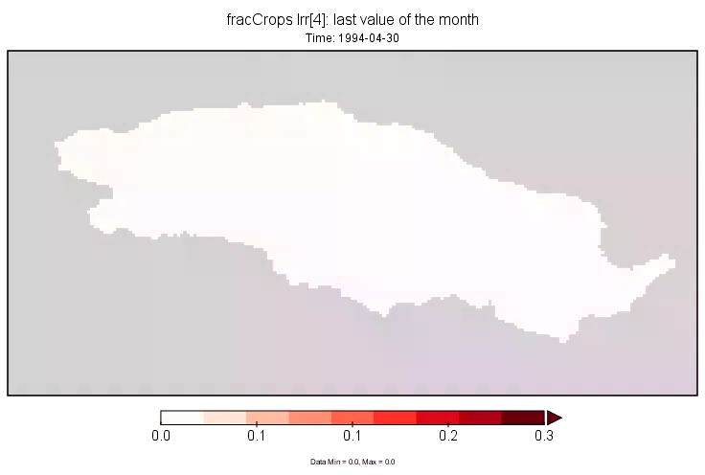
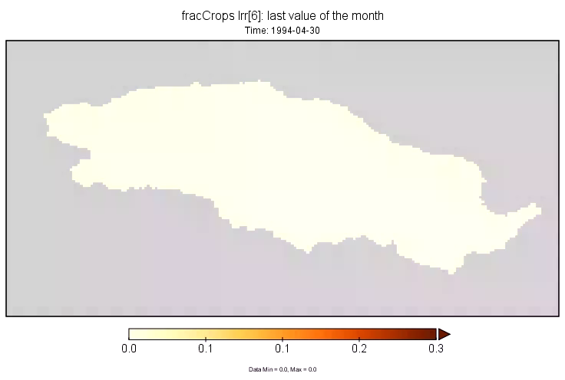

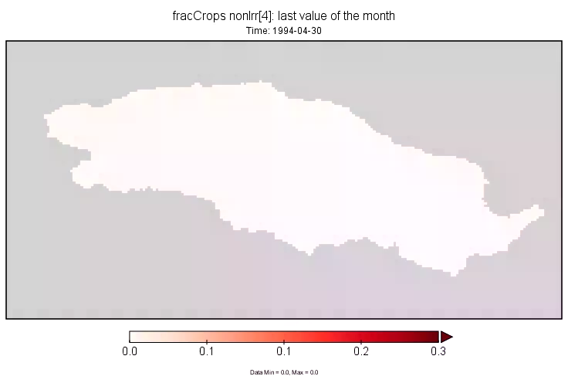
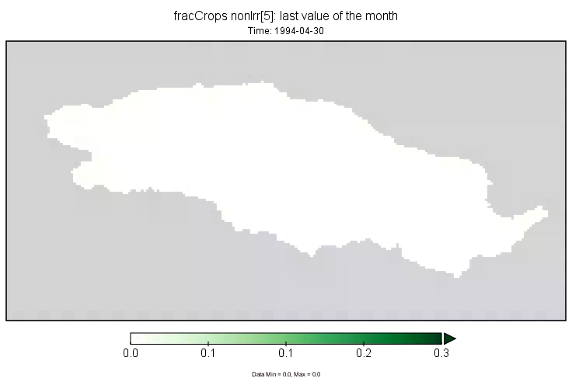
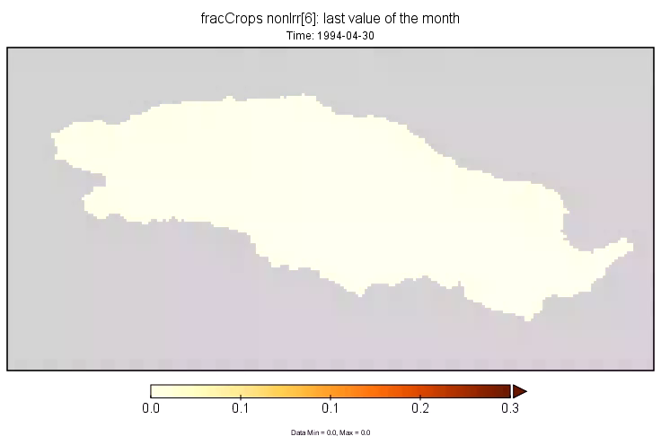
Irrigated
Sugarcane, v. pre-s
Sorghum
Groundnut
Wheat
Non-Irrigated

Slide 8
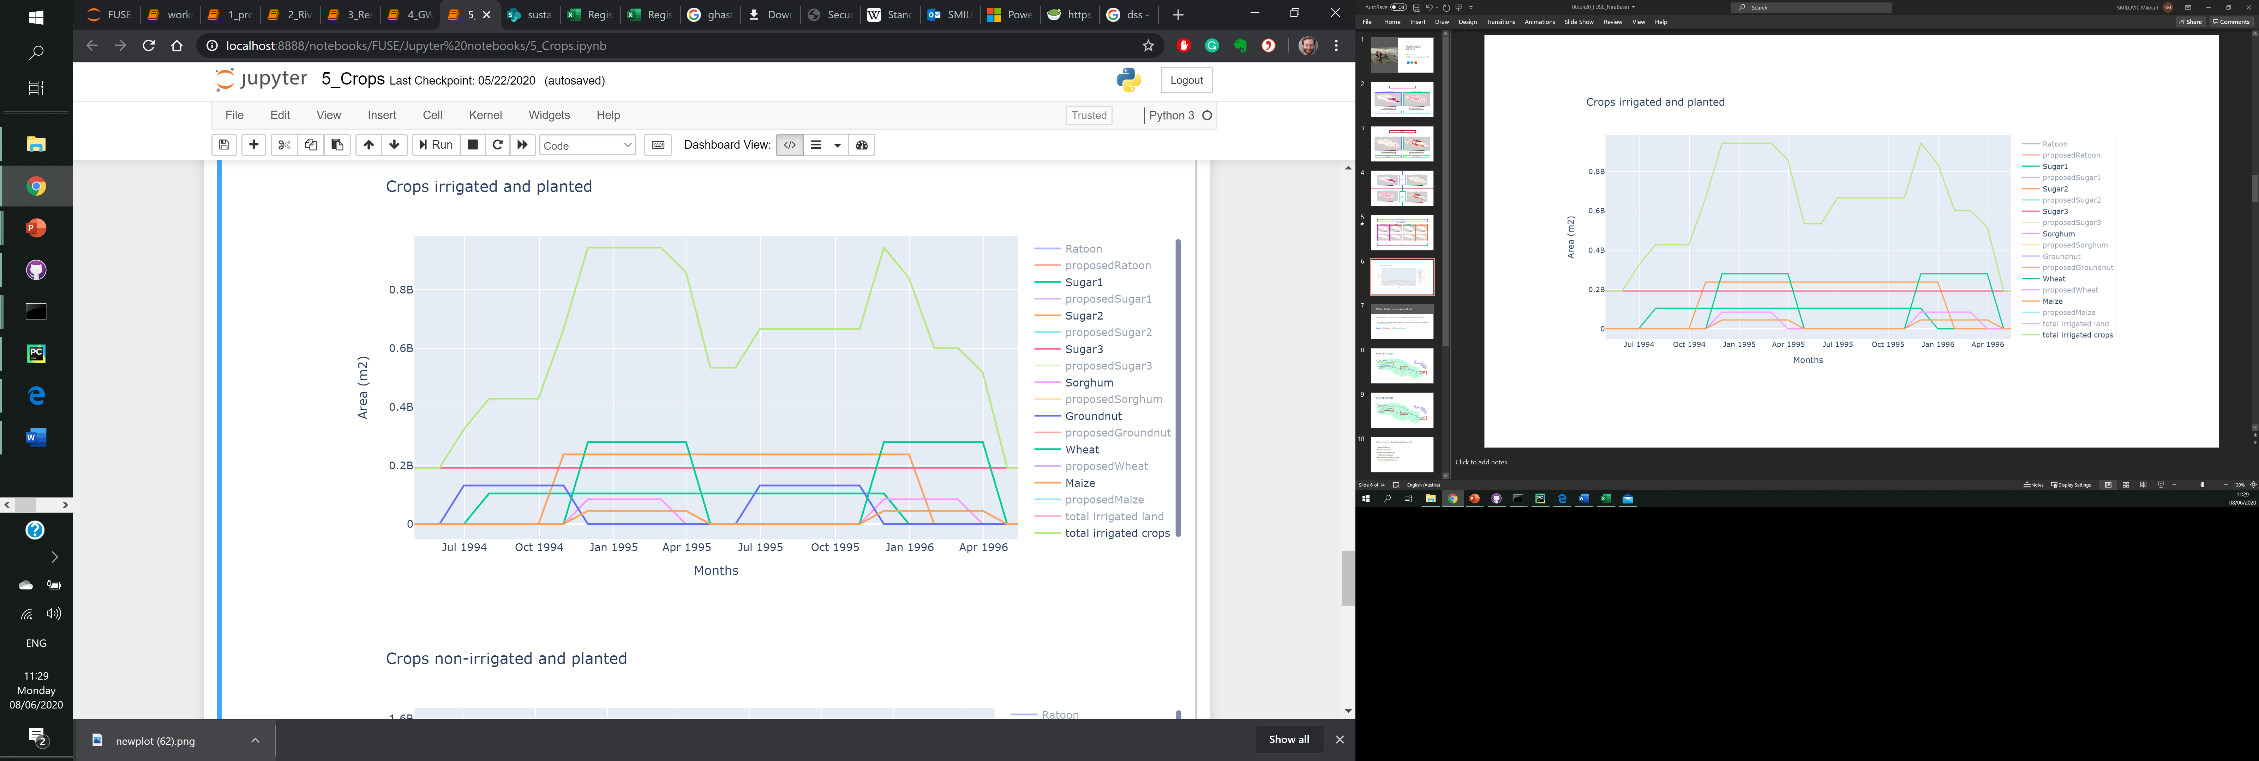
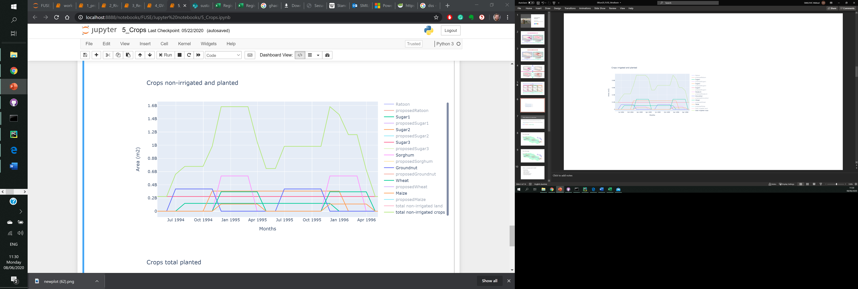

Slide 9
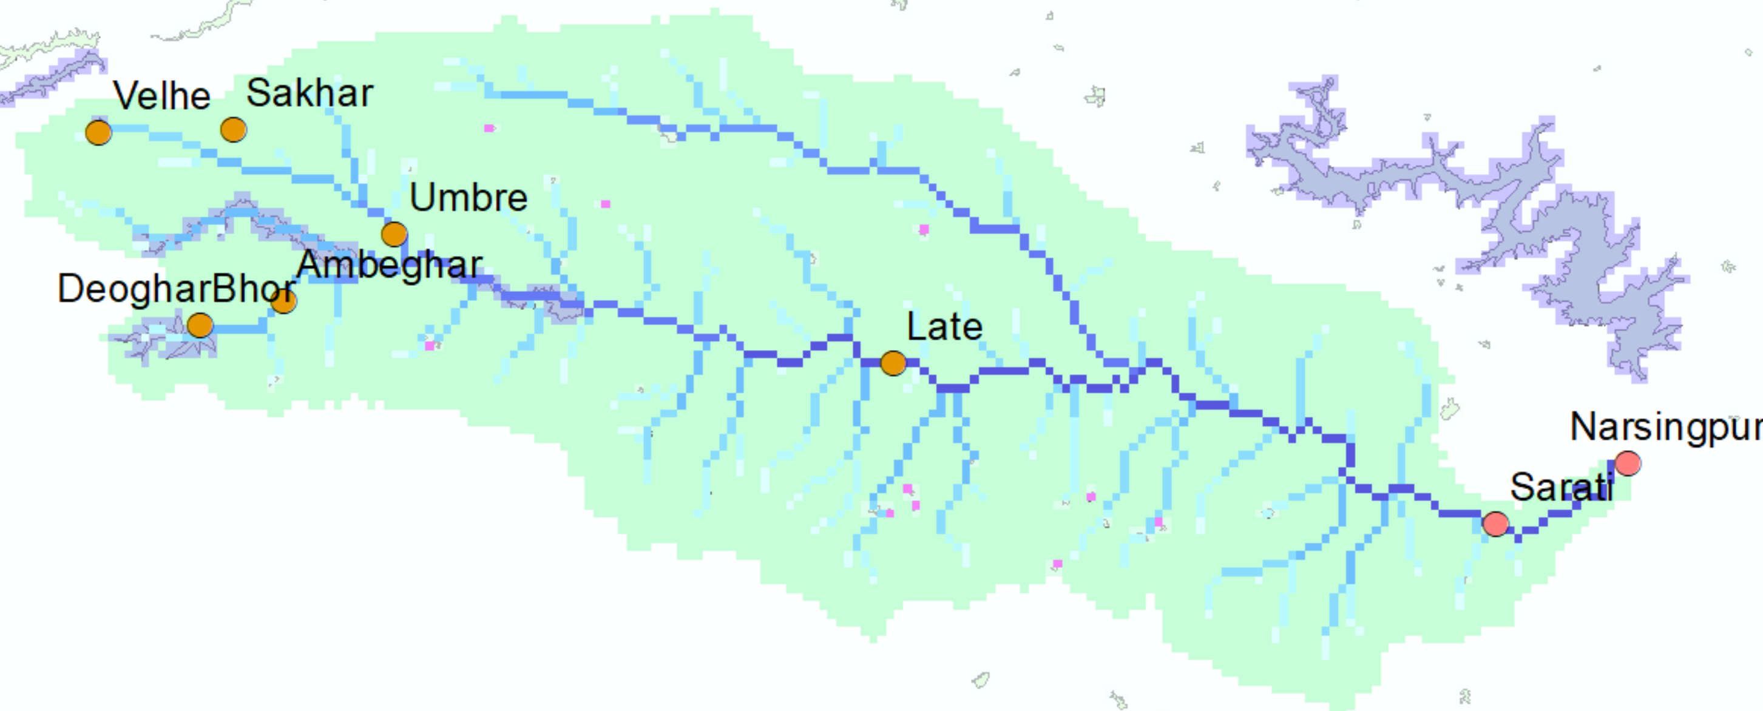
River discharge

Slide 10
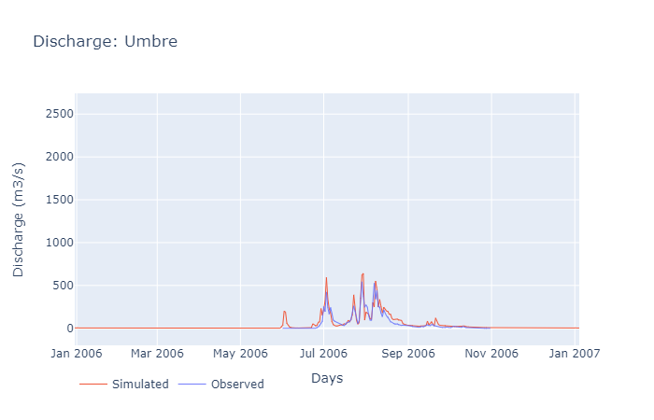
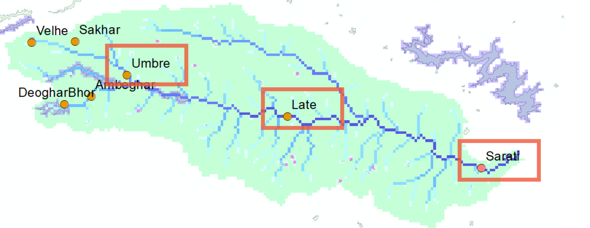
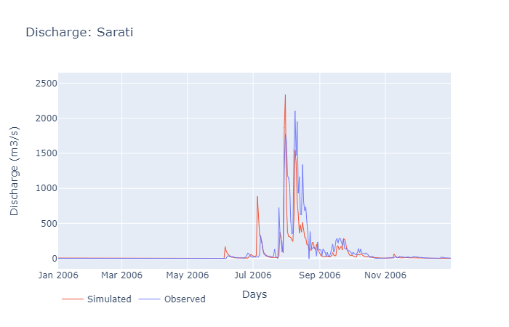
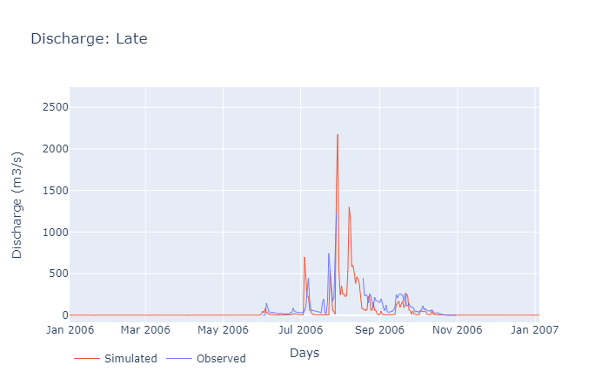
River discharge

Slide 11
What is calculated with CWatM
River discharge
Reservoir volume
Depth to groundwater
Water consumption
Potential Evapotranspiration
Actual Evapotranspiration

Slide 12
Snow
1. Snowmelt coefficient in [m/C deg/day] as a degree-day factor
Evapotranspiration
2. Crop factor as an adjustment to crop evapotranspiration
Soil
3. Soil depth factor: a factor for the overall soil depth of soil layer 1 and 2
4. Preferential bypass flow: empirical shape parameter of the preferential flow relation
5. Infiltration capacity parameter: empirical shape parameter b of the ARNO model
Groundwater
6. Interflow factor: factor to adjust the amount which percolates from interflow to groundwater
7. Recession coefficient factor: factor to adjust the base flow recession constant (the contribution from groundwater to baseflow)
Routing
8. Runoff concentration factor: a factor for the concentration time of run-off in each grid-cell
9. Channel Manning’s n factor: a factor roughness in channel routing
10. Channel, lake and river evaporation factor: factor to adjust open water evaporation
Reservoir & lakes
11. Normal storage limit: the fraction of storage capacity used as normal storage limit
12. Lake A factor : factor to channel width and weir coefficient as a part of the Poleni weir equation

Slide 13
Calibration parameters
Parameter | Value | Min | Max | Notes
Crop evapotranspiration factor | 9e-6 | 0.7 | 1.9
Soil depth factor | 1.2 | 0.8 | 1.5
Infiltration capacity | 0.4 | 0.01 | 1 | Empirical shape parameter b of the ARNO model
Interflow | 1.7 | 0.33 | 3 | Scales the amount of interflow going to channel storage and groundwater
Permeability (m/s) | 9e-6 | 5E-07 | 0.00001 | 0.0432 - 0.864 m/day
Porosity (specific yield) | 1.6% | 0.7% | 4%
River fraction factor | 0.9 | 0.5 | 2 | Scales fraction of rivers
Preferential flow factor | 7.8 | 0.5 | 8 | Empirical shape parameter of the preferential flow relation
Channel Manning’s n factor | 7.2 | 0.1 | 10 | Roughness factor in channel routing
Open water evaporation factor | 1.6 | 0.8 | 2
Lake A factor | 1.2 | 0.333 | 3 | Scales channel width and weir coefficient as a part of the Poleni weir equation
Notes:
Snowmelt coefficient in [m/C deg/day] as a degree-day factor
Recession coefficient factor: factor to adjust the base flow recession constant
Runoff concentration factor: a factor for the concentration time of run-off in each grid-cell
Normal storage limit: the fraction of storage capacity used as normal storage limit

Slide 14
